Slide 1
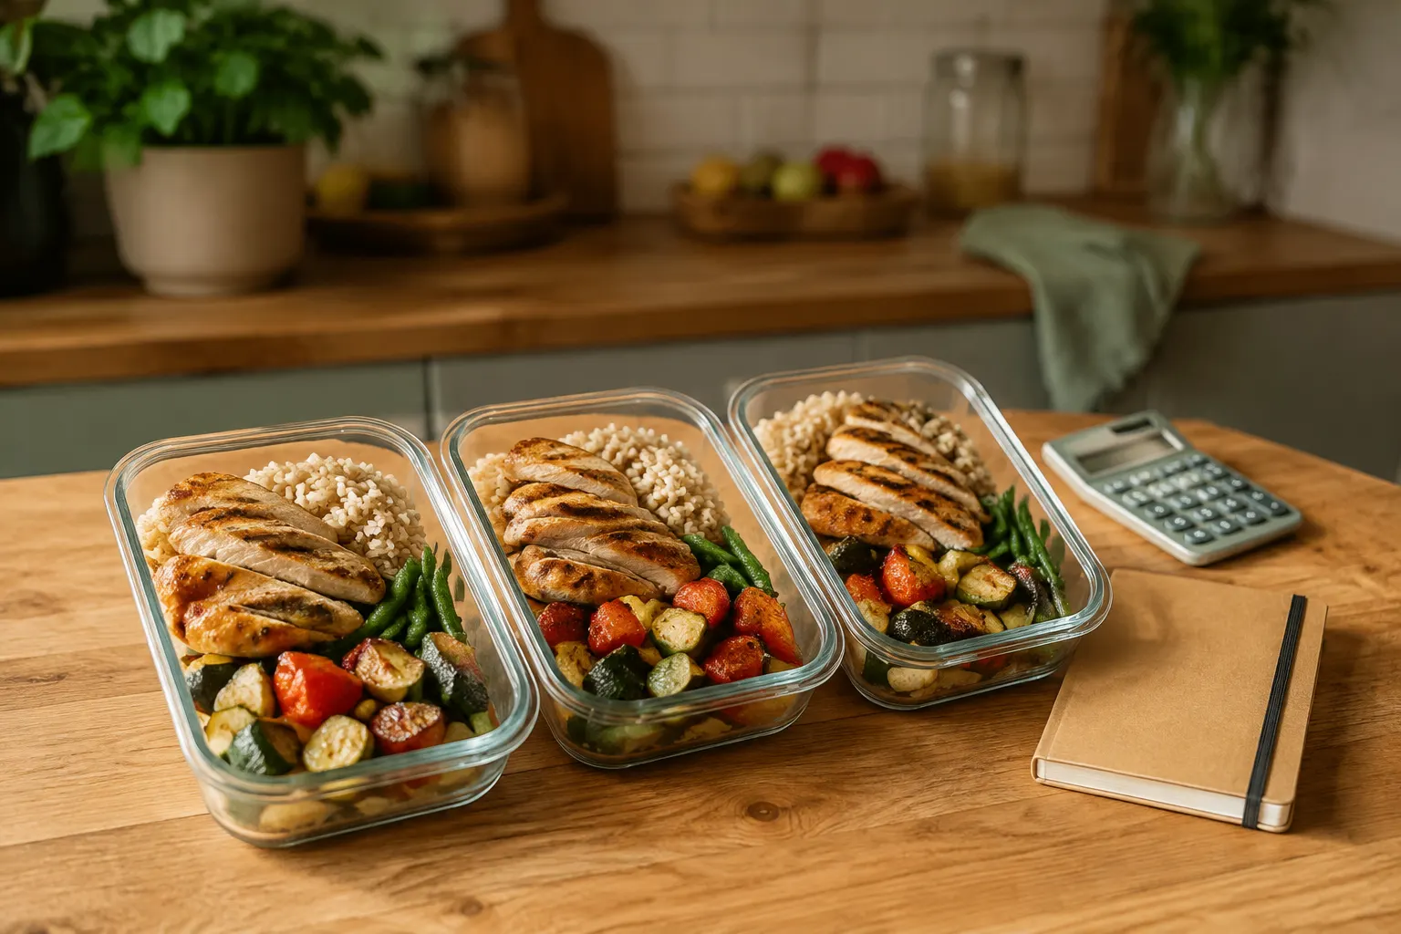
WE.LIFE / Live Smarter
WE.LIFE FOR CATERING AND RETAIL
Your offer.
At the moment of choice.
Help a customer move from “what will I eat?” to an offer that fits their plan.
Let’s explore a pilot together.
Partnership proposal • WE.LIFE — Live Smarter
1 / 8

Slide 2
WE.LIFE / Live Smarter
WHY CONTEXT MATTERS
Closer to what customers need.
WE.LIFE brings meal and shopping planning together. That is a starting point for testing where your offer adds value.
Catering
Retail
A pilot
Prepared meals as one answer to a customer’s daily plan.
Products in the context of ingredients and household shopping.
Test the usefulness of your offer within an agreed scope.
A pilot proposal, not a guarantee of sales or reach.
2 / 8

Slide 3

WE.LIFE / Live Smarter
eNZi • DEVELOPMENT DIRECTION
eNZi connects needs
with the next step.
The assistant is a starting point for using WE.LIFE. We are developing its role in bringing everyday tasks together — beyond food too.
• Today: help with app features and food-related topics.
• Planned 18+ beta: everyday questions, writing and planning.
• A direction for making the app useful between meals.
The broader assistant is not live yet. Automatic promotion of offers is not promised.
3 / 8

Slide 4

WE.LIFE / Live Smarter
PARTNER HUB
Less scattered work.
A clearer offer.
A shared place for your business profile, team roles and offer preparation.
• Prepare your menu or catalogue data.
• Organise access for team members.
• Work within an agreed pilot scope.
Access follows partner verification and permission assignment.
4 / 8

Slide 5

WE.LIFE / Live Smarter
AN OFFER PEOPLE CAN UNDERSTAND
Show what the customer
is really choosing.
Clear information helps people assess an offer before deciding. Start with the details that matter.
• Catering: ingredients, allergens, weight and nutrition.
• Retail: product, unit, price and availability.
• Accuracy: partners keep their offer data current.
Missing information is not filled in with guesses.
5 / 8

Slide 6
WE.LIFE / Live Smarter
CLEAR COMMERCIAL TERMS
Agree the terms.
Then launch.
The commercial model depends on the offer. Terms are agreed before sales launch.
Catering
Retail
Agreement
Proposed commission on confirmed, paid orders.
Scope and commercial terms are agreed individually.
Defines fees, settlement, responsibilities and customer service.
Sales and payments follow integration acceptance. A click is not an order.
6 / 8

Slide 7
WE.LIFE / Live Smarter
A CLEAR PATH TO A PILOT
From a conversation
to a tested use case.
You do not need to start with your entire catalogue. Together, we choose a useful scope to test.
01 • Choose the offer
02 • Prepare the data
03 • Test the experience
Agree on region, products and the pilot’s purpose.
Organise information, access and responsibilities.
Check publication and the agreed customer journey.
The agreement defines customer-data access and each party’s duties.
7 / 8

Slide 8
WE.LIFE / Live Smarter
LET’S TALK ABOUT YOUR OFFER
Let’s put it
to the test.
Tell us what you offer and where you operate. Let’s agree on the first step of a pilot.
sales@welife.world
+48 512 318 632
welife.world/partners/catering
Partner workspace: welife.world/partner/hub
8 / 8

