Slide 1

WE.LIFE / Live Smarter
MEET eNZi • WE.LIFE
eNZi.
Bring your day
together.
Your everyday conductor in WE.LIFE. Connect a question, a plan and the next step — while staying in control.
You set the direction. eNZi helps connect the steps.
Today: WE.LIFE and food support. Broader assistant: planned 18+ beta.
1 / 8

Slide 2
WE.LIFE / Live Smarter
eNZi • BRING YOUR DAY TOGETHER
Many moving parts.
One place to start.
Like a conductor bringing an orchestra together, eNZi helps connect your needs with WE.LIFE’s features. You stay in control.
Say what you need
Connect the next steps
Review and confirm
Start with a food question or ask for help using the app.
Move from a need to a plan, recipe, pantry or shopping.
Check the suggestion. Confirm actions in the app.
Current scope: available WE.LIFE features and food topics. AI can make mistakes.
2 / 8

Slide 3
WE.LIFE / Live Smarter
WHAT’S NEXT • PLANNED BETA 18+
Everyday questions.
A broader role for eNZi.
We are building help beyond the kitchen. You do not need the perfect prompt — start with the task on your mind.
“How can I word this?”
“What does this mean?”
“Where do I start?”
Help drafting a message, a reply or a short piece of writing.
A simpler explanation of an idea or help with learning.
Break down a task, organise ideas or outline your day.
Planned features. Adult beta after testing; terms and limits shown before use.
3 / 8

Slide 4
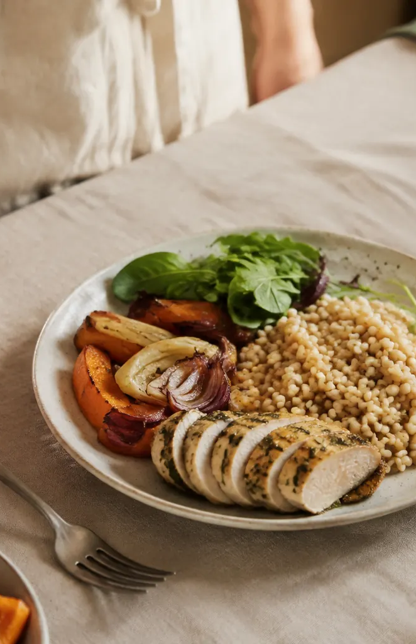
WE.LIFE / Live Smarter
FEWER EVERYDAY DECISIONS
“What’s for dinner?”
Have an answer ready.
Open your meal plan instead of starting from scratch.
• Choose meals that fit your day.
• Go from an idea to a step-by-step recipe.
• See what to prepare and what to buy.
Meal planning • recipes • shopping list
4 / 8

Slide 5
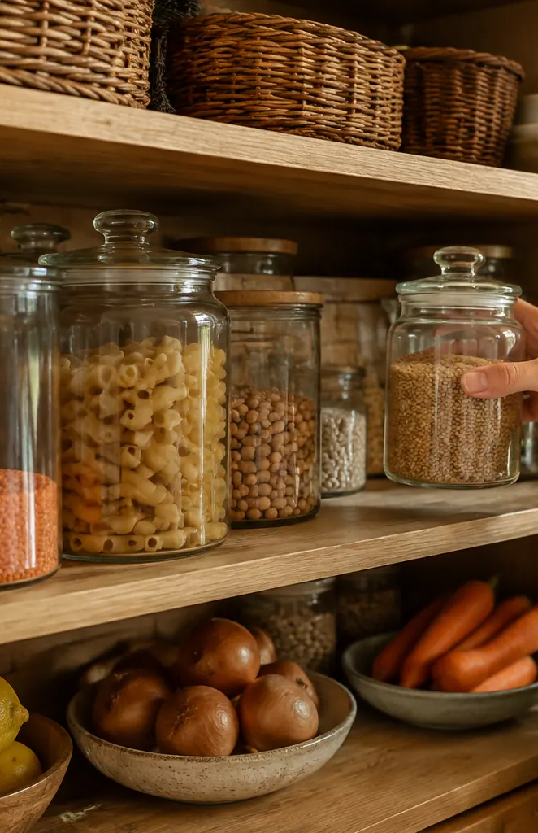
WE.LIFE / Live Smarter
SHOP WITH A PLAN
Start with what
you already have.
Connect your pantry to your meal plan. Spot what is missing and make duplicate purchases easier to avoid.
• Keep a record of pantry items.
• Check the ingredients your meals need.
• Take a list to the store, not a memory test.
A clearer shopping routine; no fixed savings promised.
5 / 8

Slide 6
WE.LIFE / Live Smarter
A PLAN FOR YOUR HOUSEHOLD
Different needs.
One place to start.
You do not have to remember everyone’s preferences from scratch. Household profiles help shape the plan.
• Keep household preferences in mind.
• Connect planning with supplies at home.
• Keep shopping information close at hand.
Always check ingredients and labels when managing allergies.
6 / 8

Slide 7

WE.LIFE / Live Smarter
AS MUCH DETAIL AS YOU NEED
Your routine.
Everyday or Fit.
Just want to plan your meals? Or follow your balance and progress? Choose how you use the app.
• Everyday: meals, pantry and shopping.
• Fit: goals, balance and progress history.
• Activity: a place for your training plan.
WE.LIFE supports everyday habits. It does not diagnose or treat.
7 / 8

Slide 8
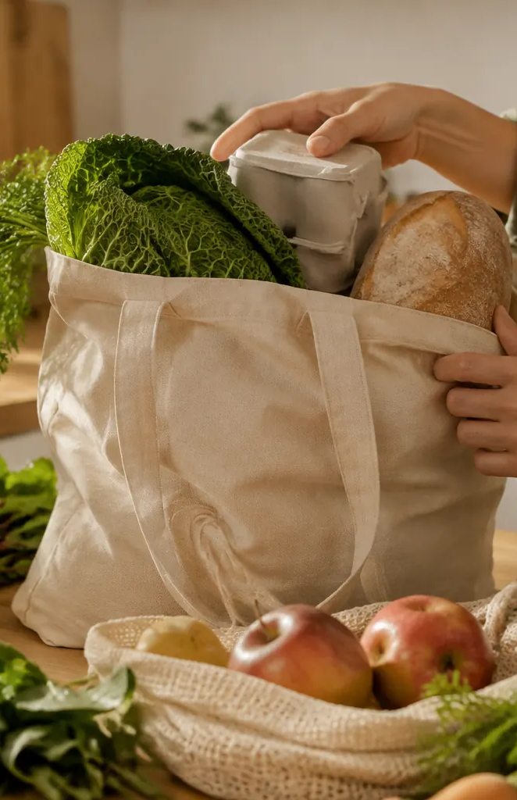
WE.LIFE / Live Smarter
START WITH ONE THING
Start with what’s
on your mind today.
Meals to plan? Shopping to organise? Explore WE.LIFE and eNZi — from one need to the next step.
Visit welife.world
Explore the app and eNZi’s help.
sales@welife.world • +48 512 318 632
Beta access depends on enabled modules. Available through a browser.
8 / 8

